Slide 1
Computers & Society
Extension Slides

Slide 2
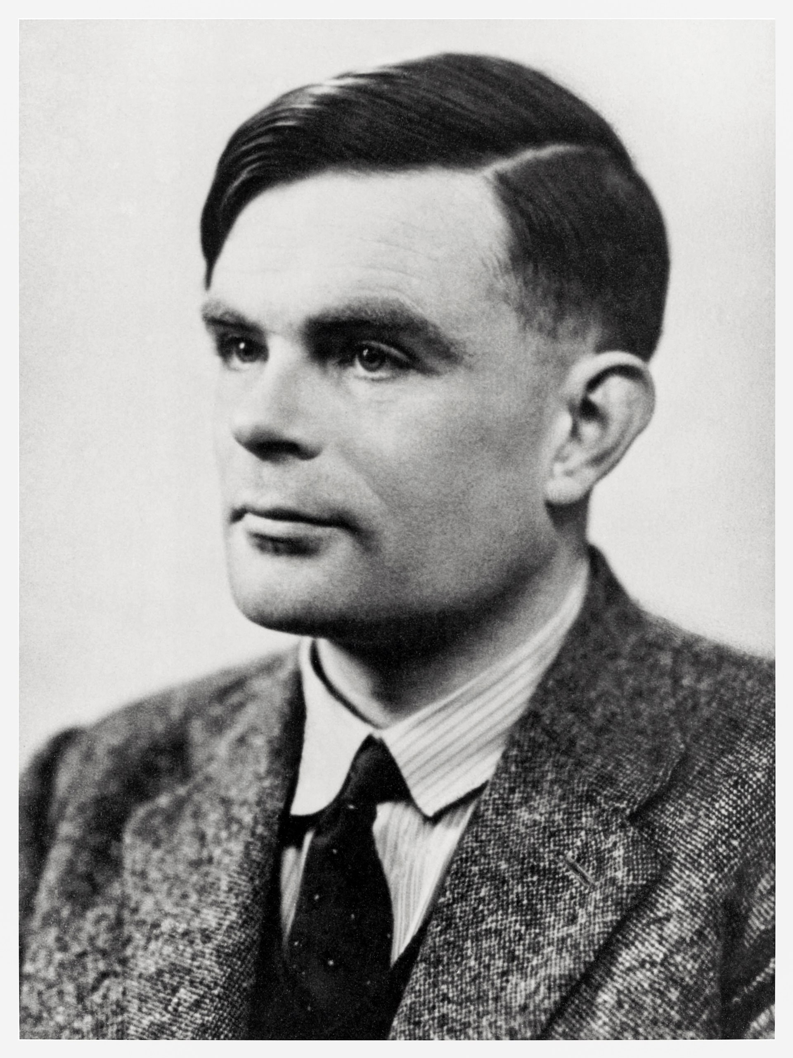

Artificial Intelligence
in History
The Turing Test – can a person tell a computer from a human?
Can a machine actually become conscious?
Will an A.I. ever be as intelligent as a human?
Is the human mind a physical thing?
Can a machine think?
Alan Turing
Notes:
Let’s talk about the history of A.I.
Alan Turing was known as the “father of artificial intelligence”
Seriously recommend reading more about him, he is an incredibly impactful and interesting person
One of his contributions to the field was the “Turing Test” – a way to measure how “intelligent” an artificially intelligent agent actually is
This involves a judge having a conversation via text with two “people” – one, a real person, and the other, a computer
If the computer can successfully fool the judge, it has passed the test!
Poll the students with this question: “Can a machine think?”
Have them put up fingers or answer in the Zoom chat:
1 for yes
2 for no
3 for maybe/not sure/depends
Poll the students in the same way with the following questions
Can a machine actually become conscious?
Will an A.I. ever be as intelligent as a human?
In this case, it means generally intelligent, i.e., able to solve any problem a human can solve
Is the human mind a physical thing?
https://plato.stanford.edu/entries/turing-test/
https://plato.stanford.edu/entries/chinese-room/

Slide 3

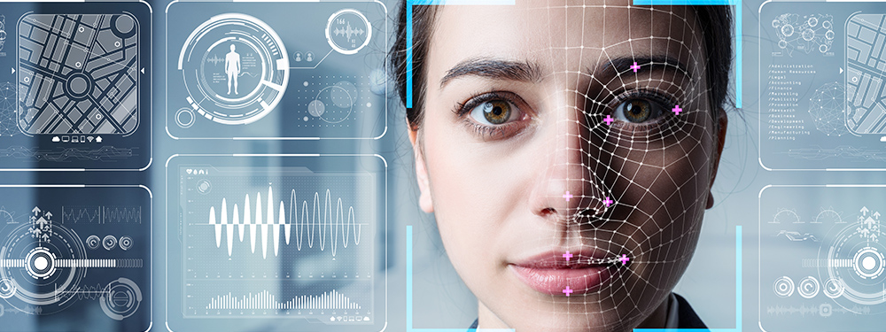
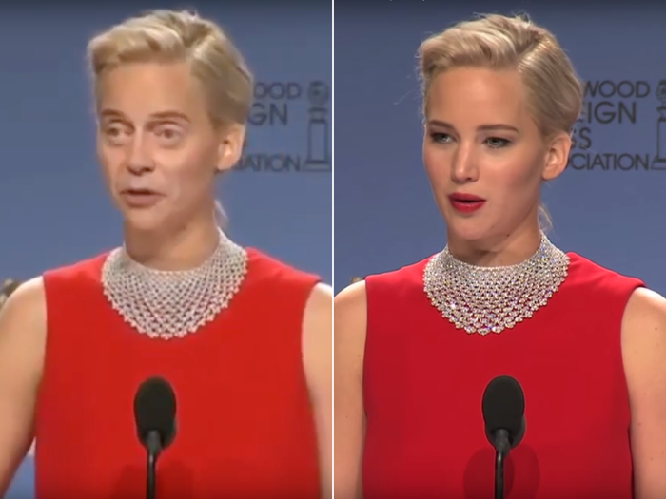
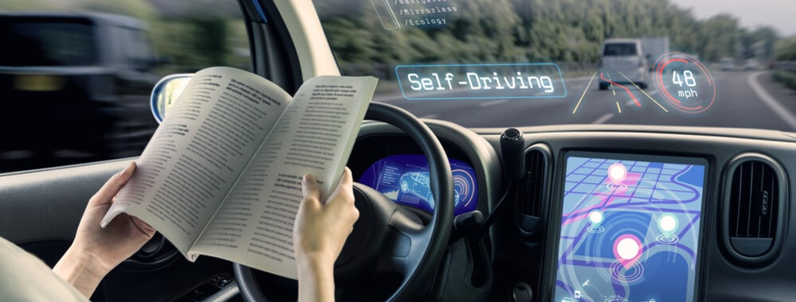
A.I. is Everywhere
Recommendation Engine
Deep learning – neural networks
Different measurements of success
Facial Recognition
TikTok or Snapchat filters
Data theft, algorithmic bias
Deepfakes
Self-Driving Cars
Litigation, job replacement
Notes:
Now let’s get into some specific technologies that are having an impact on the world today.
A.I. is a huge field that has been changing the world in many ways. We will consider just a few of them.
Ask the students if they have ever used YouTube. Ask them how they think YouTube uses A.I.
Reveal that their recommendation engine is powered by A.I.
This is possible because of deep learning & neural networks – we will not explore the technical details
Ask the students how they might measure the success of a recommendation engine
Maybe number of times a video was clicked? Why could that be bad? It could lead to manipulations via clickbait
Maybe length of time watched on the recommended video? But that could lead to saturated long videos
Maybe number of times a recommended video was liked? But maybe people don’t like videos even if they enjoyed them
Ask the students for examples of facial recognition
A big one is TikTok or Snapchat filters (or Instagram or whatever)
iPhone face ID is another one
Go over some of the key concerns with facial recognition
Data theft – big companies or even foreign governments could steal facial data and use it for malicious purposes (such as something we’ll cover later)
Algorithmic bias – imagine if facial recognition was used to identify criminals. Now, imagine the algorithm was only trained on white people, and can’t recognize people of other races... This could be a serious issue for an individual identified as someone else based on race alone.
Ask the students if there are any ethical concerns with self-driving cars
A big question is litigation – who gets in trouble if the car runs someone over? The driver? The programmer? Elon Musk?
This is also an example of a larger issue of technological unemployment – what if all the truckers lose their jobs?
Ask the students if they have heard of deepfakes
Show a quick example of Jennifer Lawrence turning into Steve Buscemi
We will dig into deepfakes a little deeper on the next slide…
https://towardsdatascience.com/how-youtube-recommends-videos-b6e003a5ab2f
https://www.forbes.com/sites/johnkoetsier/2019/07/17/viral-app-faceapp-now-owns-access-to-more-than-150-million-peoples-faces-and-names/?sh=40e97c1f62f1

Slide 4
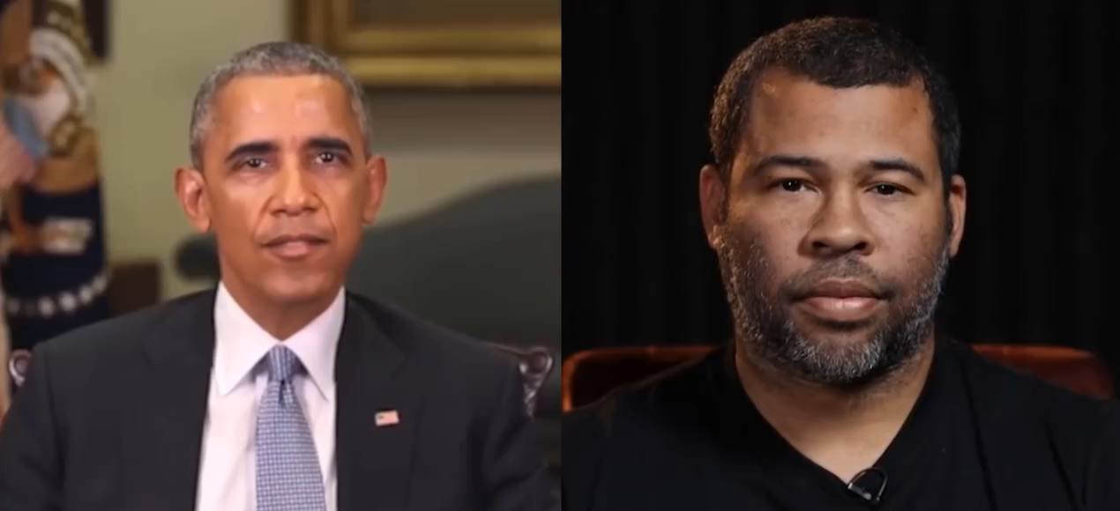
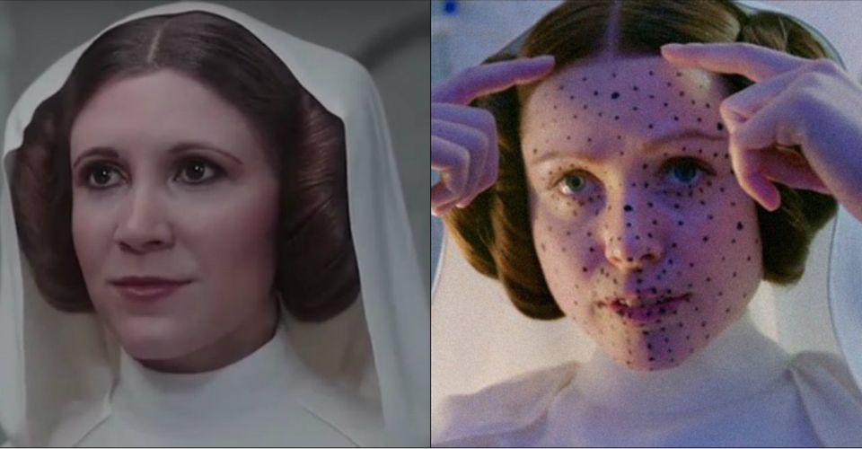



Deepfakes
“Deep Learning” + “Fake”
Deepfakes can spread dangerous misinformation
They can be used for many nefarious purposes
Detection can be hard
Kendrick or Will?
Notes:
Now we are going to dive deeper into deepfakes
Ask the students if the recognize this person
It’s actually Kendrick Lamar, but he’s wearing the deepfake “mask” of Will Smith
We will not be watching the video (The Heart Part 5) because it’s DEFINITELY not appropriate for this camp, but it’s culturally relevant
This is possible via “Deepfake” technology – portmanteau of “deep learning” and “fake”
There are several other legitimate examples, like young Carrie Fisher in Rogue One
There is also a platform named Synthesia that generates 100% A.I.-based people for use in business videos, and potentially other media
Play the video, and explain that it’s not a real person, or a real voice!
However, it’s not all good… show the video of “Obama” saying that we need to be vigilant on the internet
Then, reveal Jordan Peele and play the video again – showing that it was fabricated
Explain that deepfakes can spread dangerous misinformation – think about political figures being manipulated in that way
There are many nefarious purposes for deepfakes, mainly involving fraud
As the technology improves, it becomes more and more difficult to detect deepfakes
Companies like Twitter are working on tagging synthetic videos and making sure no one is misled
Ask the students if they can think of ways deepfakes could be used, for good or bad
https://www.youtube.com/watch?v=fM2pqqfukNc

Slide 5
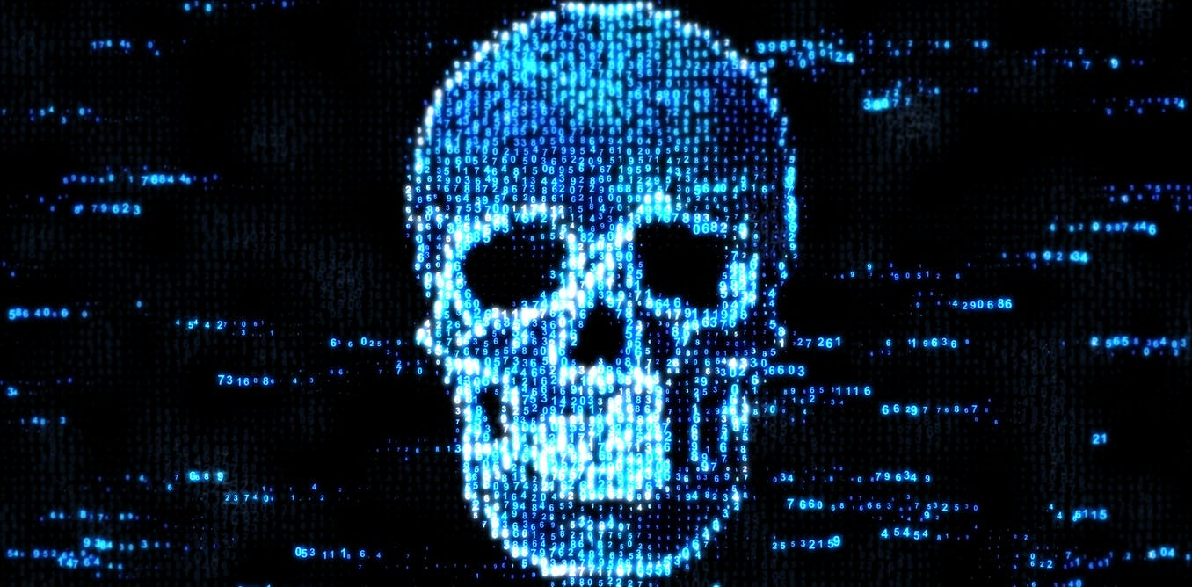

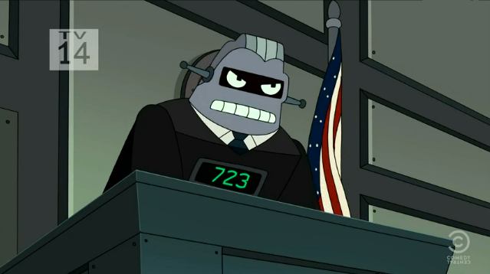

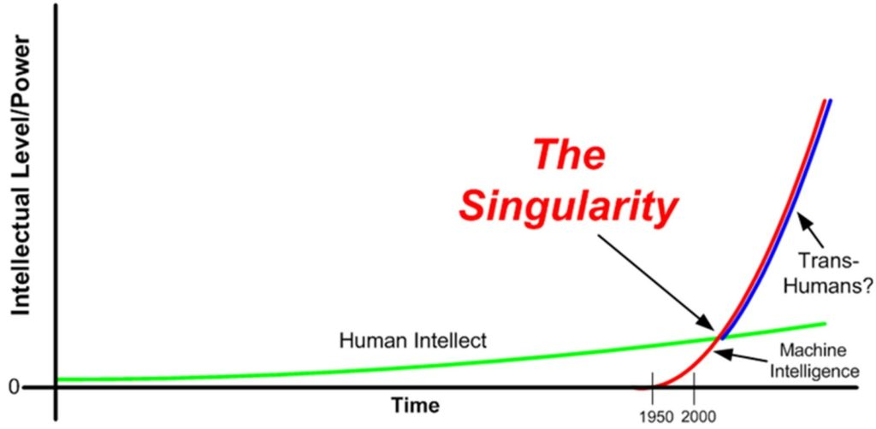
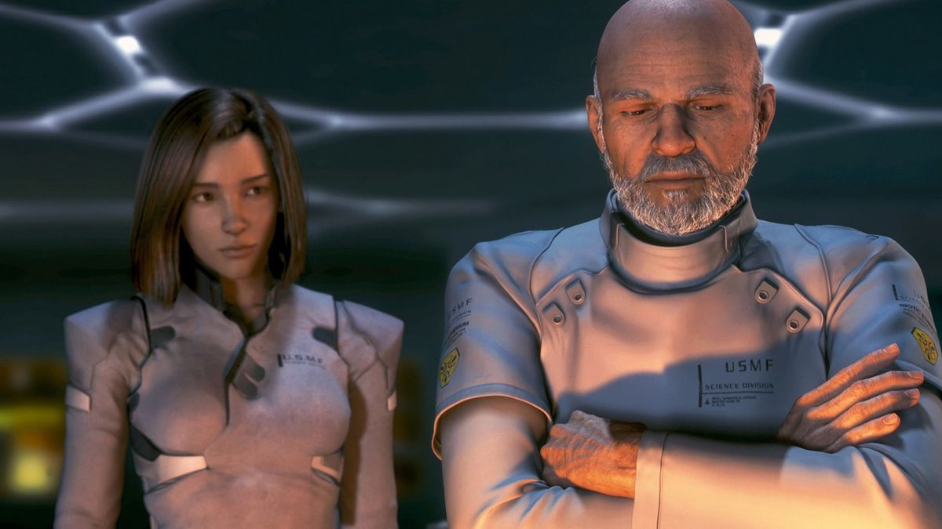
The
Future
of A.I.
How might artificial intelligence impact the future?
Government by Algorithm
Intelligence Explosion
When technological growth becomes uncontrollable and humanity changes forever
Fully A.I.-Generated Films
Notes:
Now let’s dive into some of these future technologies. We’ll start with an emerging one – artificial intelligence
Ask the students if they have any ideas for how A.I. could impact the future
One example – government by algorithm – there have been some real-world examples of AI getting involved in politics
In Japan, an artificial intelligence ran for public office
In the 80s, there was a software called “Split Up” that handled divorce proceedings, and split up estates
Poll the students: would you like to be governed by an artificial intelligence?
Another potential future would be deepfake films
The A.I. could generate the visuals, the audio/dialog… could even write the story!
Poll the students: do you think a fully A.I.-generated movie would be good?
Now for a less realistic idea – Ask the students if they’ve heard of the “singularity”
This is a hypothetical point in time at which technological growth becomes uncontrollable and irreversible, resulting in unforeseeable changes to human civilization.
This could cause an “intelligence explosion” – basically, if an Artificial General Intelligence is capable of improving itself, there’s nothing stopping it from continuous improvement… which makes it get faster and faster and better and better at an accelerated pace
This could lead to a superintelligence – something humans could not even comprehend, way beyond any human intelligence
One fun thought experiment is a paperclip maximizer – say a superintelligence had a goal of creating paperclips. It might neglect all other responsibilities and simply optimize its ability to create paperclips – thus destroying the universe.
Poll the students: Will a technological singularity happen?
https://en.wikipedia.org/wiki/Split_Up_(expert_system)
https://mitpress.mit.edu/books/technological-singularity
https://www.lesswrong.com/tag/paperclip-maximizer

Slide 6
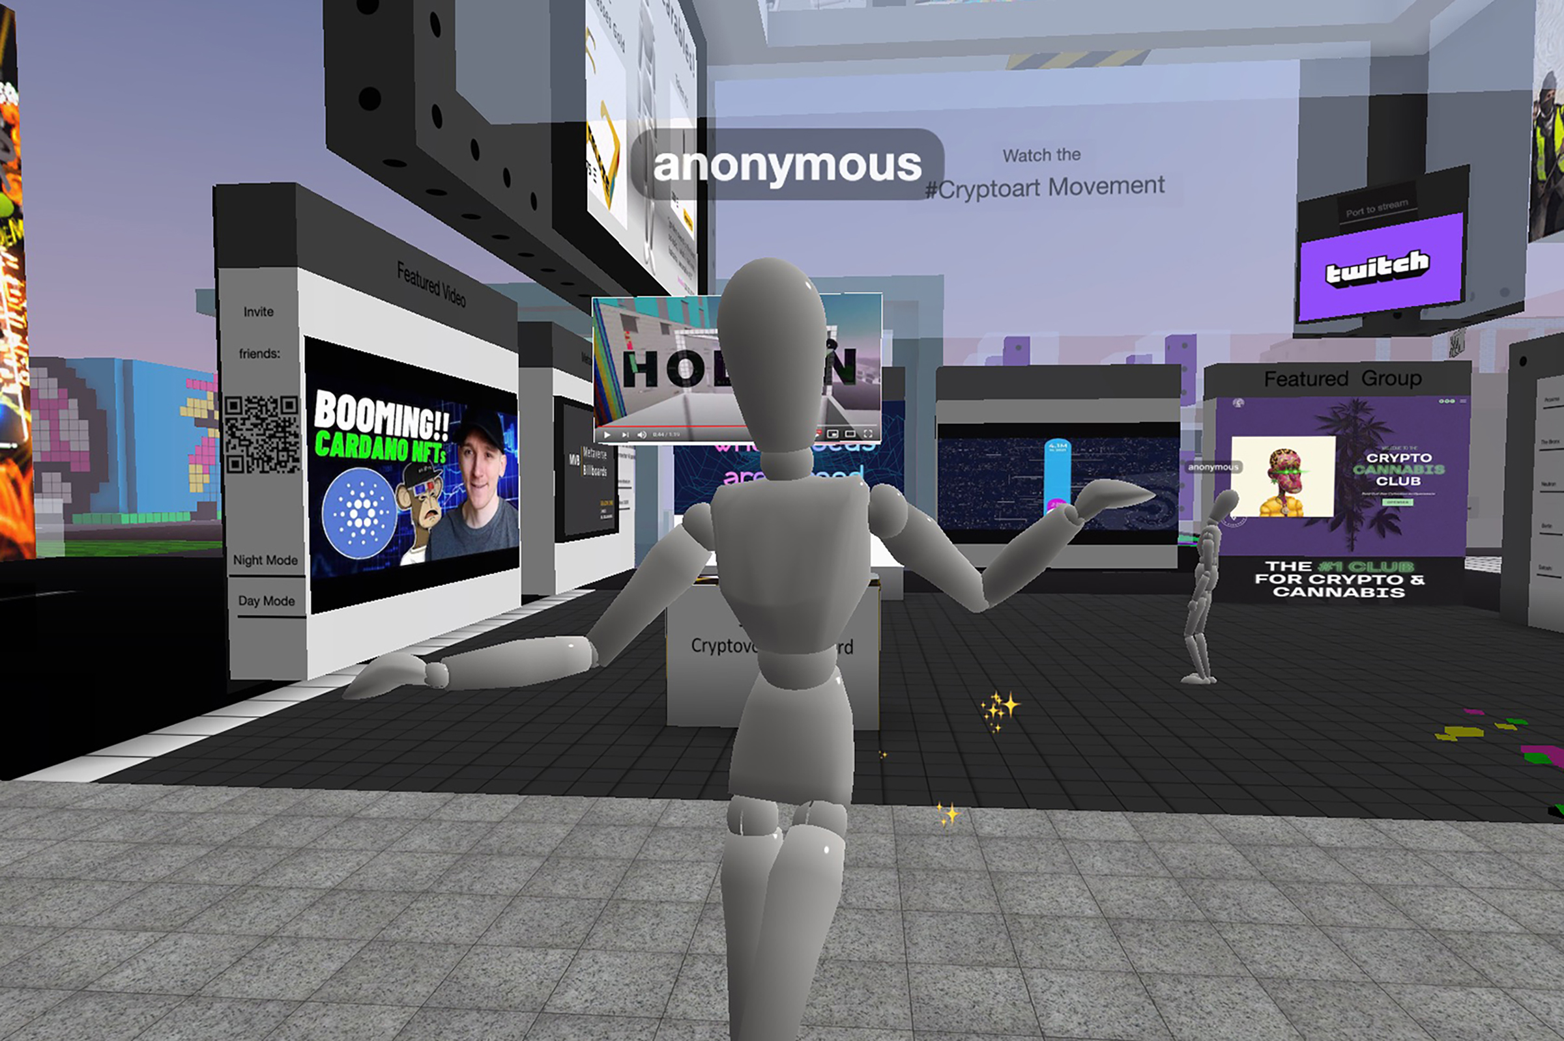

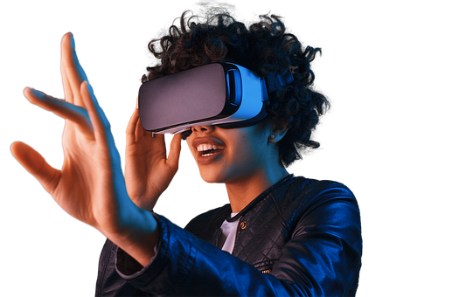

Extended Reality (XR)
Virtual Reality
Augmented Reality
Metaverse
Is virtual real estate a good investment?
Notes:
On the topic of reality, let’s get into another area of technology – extended reality (e.g. non-reality reality)
Ask the students if they know what VR stands for, and if they have examples of VR Headsets. It stands for Virtual Reality
Oculus Quest, HTC Vive, Google Cardboard
VR is fully immersive, and is meant to take the user into another world
VR is largely used for entertainment, but can also be used for education/training, healthcare, and more
Ask the students if they know what AR stands for. It stands for Augmented Reality
In Augmented Reality, a layer of non-reality is added to normal reality – an example is Pokemon Go
Ask the students if they have any ideas how AR could be used
Outside of gaming, there are applications in art, commerce, architecture, and more
Ask the students if they’ve heard of the metaverse
The term actually originated in a 1992 novel by Neal Stephenson called Snow Crash – it’s a portmanteau of “meta” and “universe”
The “metaverse” is a universal immersive virtual world, facilitated by the use of VR and AR
Recently, the idea of Blockchain and NFTs (Web3) have been incorporated into the metaverse – digital ownership is an important concept
“Virtual Land” in the metaverse is selling for hundreds of thousands of dollars right now (virtual real estate is an oxymoron)
Poll the students with this question: “Is virtual real estate a good investment?” (1 for yes, 2 for no, 3 for maybe/not sure)

Slide 7
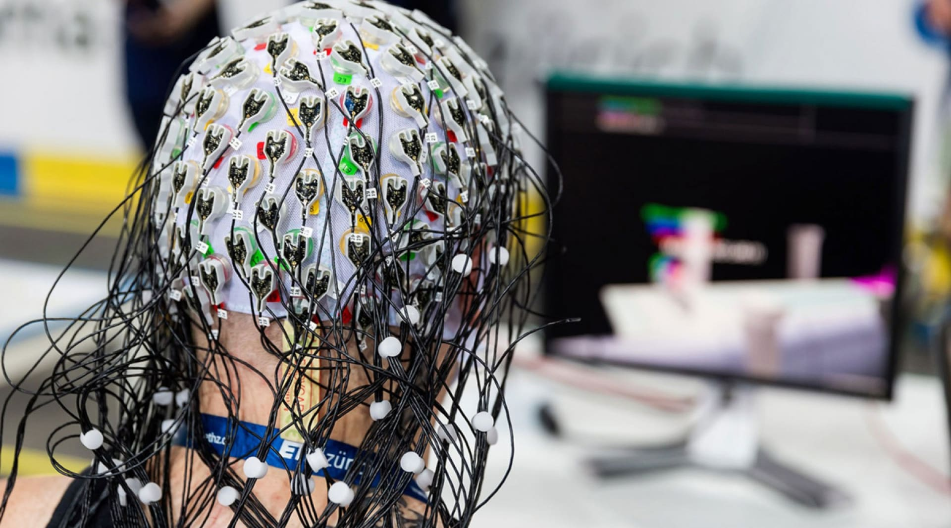
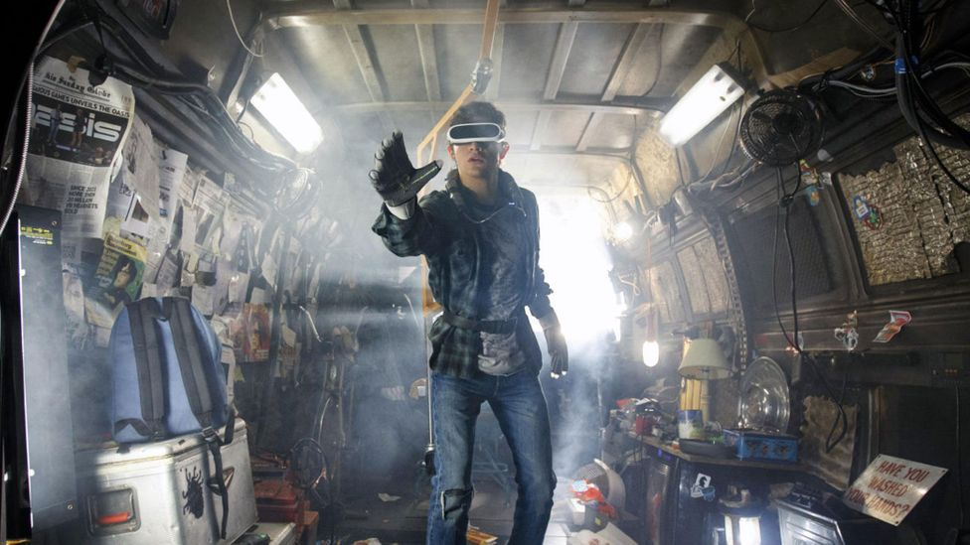
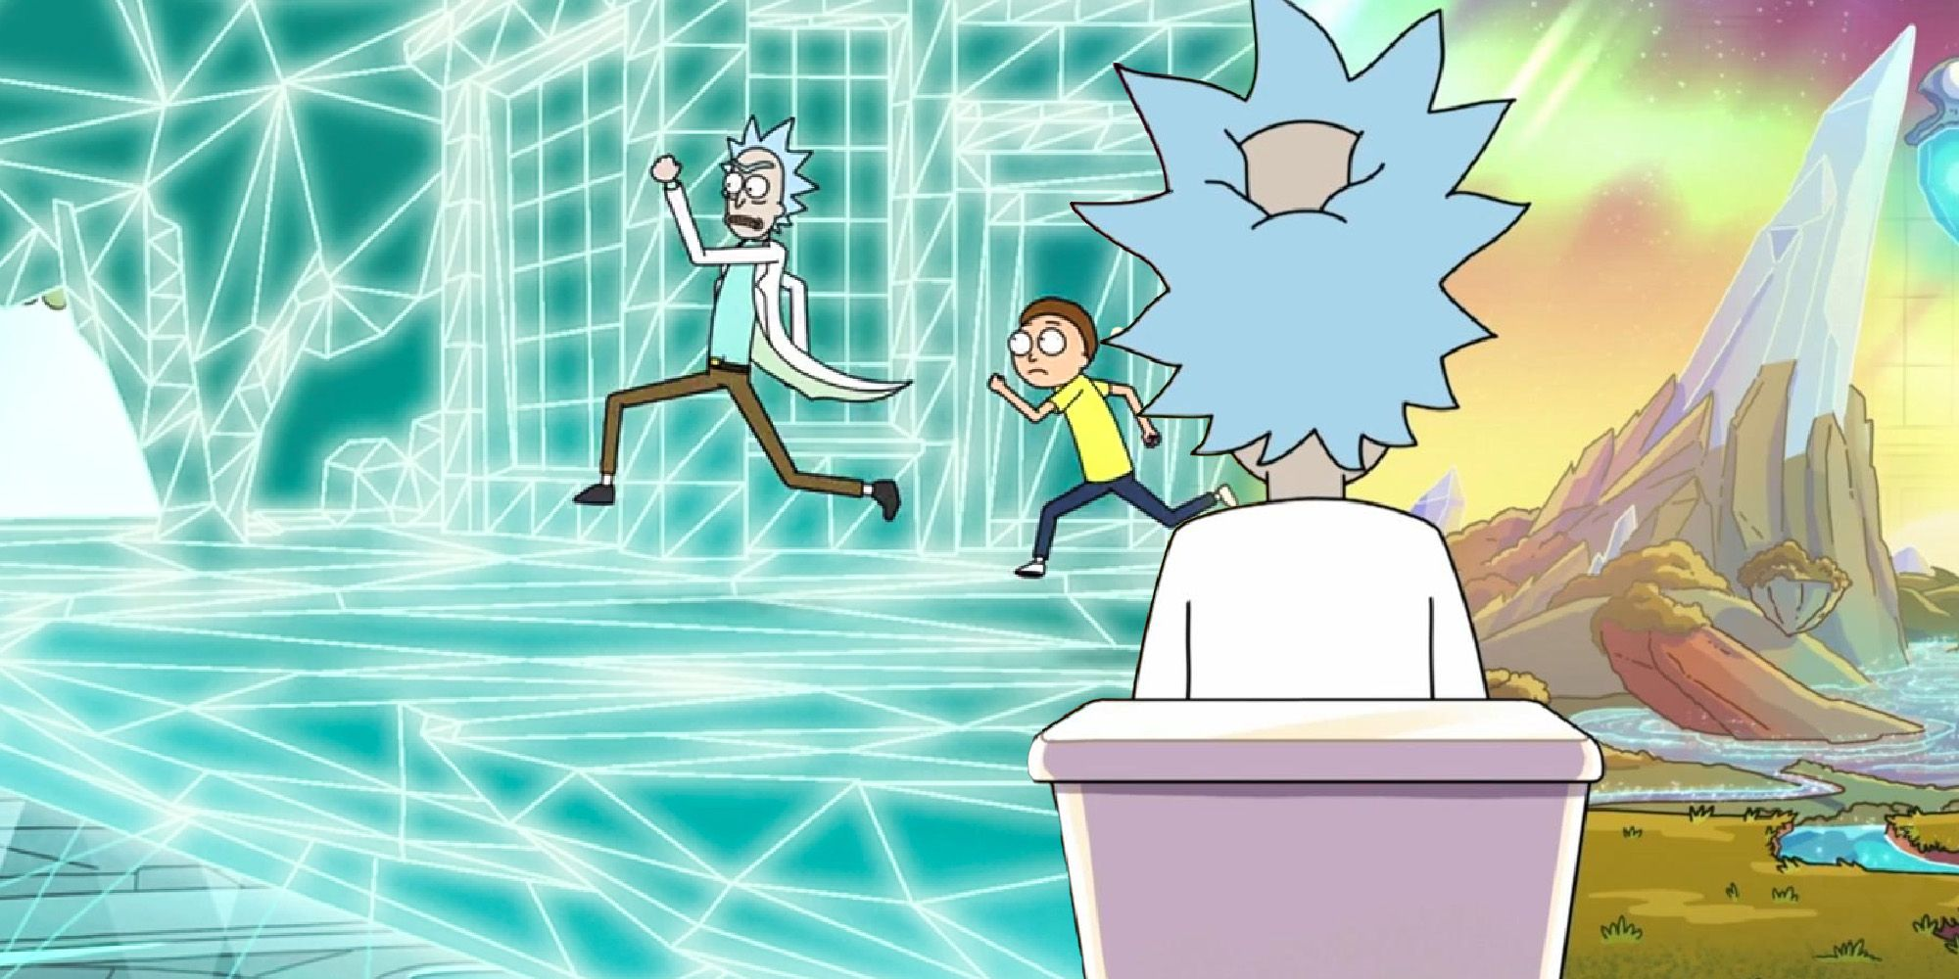
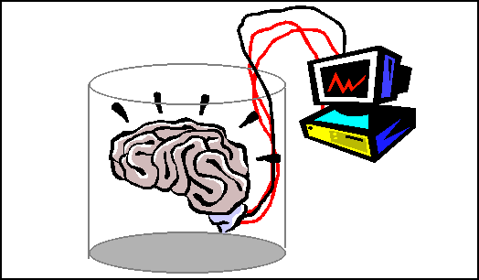
The
Future
of Extended Reality
How might extended reality (VR/AR/etc) impact the future?
Virtual Society
Brain-Computer Interface
Are we living in a simulation?
Does it matter?
Notes:
Let’s talk about another emerging technology – extended reality
Ask the students if they have ideas about how Extended Reality could impact the future
One possibility is a complete virtual society – like in Ready Player One
People might spend more time in VR than they do in real life
Entire economies, cultures, and communities could exist digitally
Another possibility, that may be a little more out there – Brain-Computer Interfaces mostly exist for prosthetic limbs – being able to read impulses from the brain
But what if it were possible to use a brain-computer interface to completely stimulate a person’s perception?
If that’s possible, extended reality might become so advanced that it is completely indistinguishable from our reality…
Poll the students: Are we currently living in a simulation?
Follow-up question: does it matter if we’re in a simulation?
http://consc.net/reality+/excerpt.pdf

Slide 8
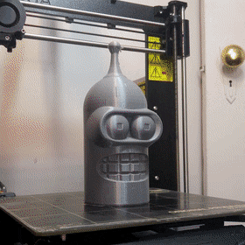
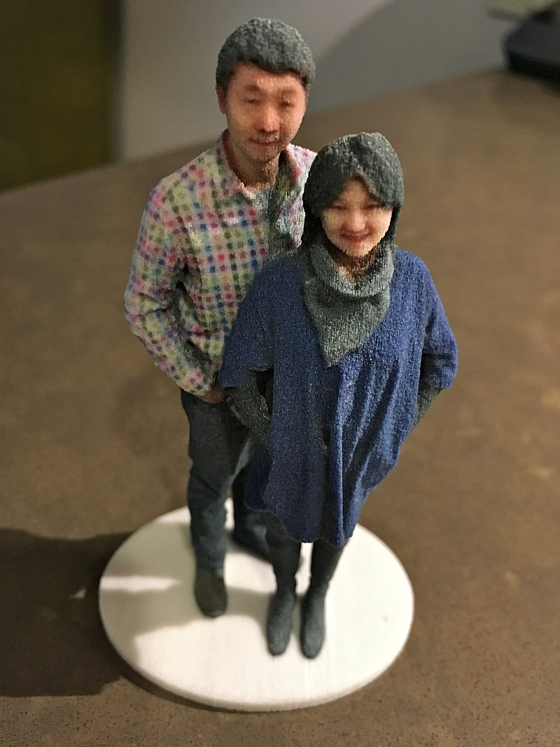
3D Printing
What can be printed?
D&D miniatures
Car parts
Prosthetics
Selfies
Architecture
3D Printers
Notes:
Now let’s shift gears from the virtual to the real – computers can make things beyond the digital world!
Show the example – ask the students if they recognize this robot (Bender from Futurama)
3D printing is the construction of a physical object from a digital model – usually plastics, but other materials can also be used (like chocolate)
Ask the students for some ideas of what they could 3D print
There is a list of some of the things that can be printed – but there’s definitely more than that!

Slide 9
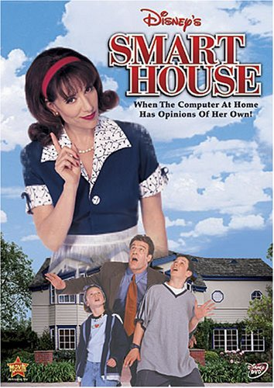

Smart Devices - IoT
Would you want to live in a smart house?
IoT (the Internet of Things) – a network of “smart” devices that connect with each other or the internet. Devices like…
Smart doorbells, locks, TVs, lights, fridges...
What could go wrong?
security, privacy, control
Notes:
Poll the students: Would you want to live in a Smart House like from the DCOM?
Basically, a house where everything is controlled by a computer connected to the internet and is running software
In the 1999 when this was released, a “Smart House” was far from reality… but now it’s not too far off
So what is the Internet of Things? Well, it’s basically a smart house – a network of “things” (aka smart devices) that are capable of running software, and connecting to the internet (or each other)
Ask the students for examples of “smart” devices
Reveal a few examples of smart devices
Ask the students for some potential concerns with smart devices
Reveal some potential concerns
General security – there is extra vulnerability – compromising one device could compromise an entire network
Privacy – companies (cough cough Amazon) could take data about your home or living habits, and use it to sell you things
Control – if someone else hacked your system, they could make things very bad (e.g. locking doors, turning up the heat, etc)
Also, your house might gain sentience, assume a corporeal form, and wreak havoc on your family

Slide 10
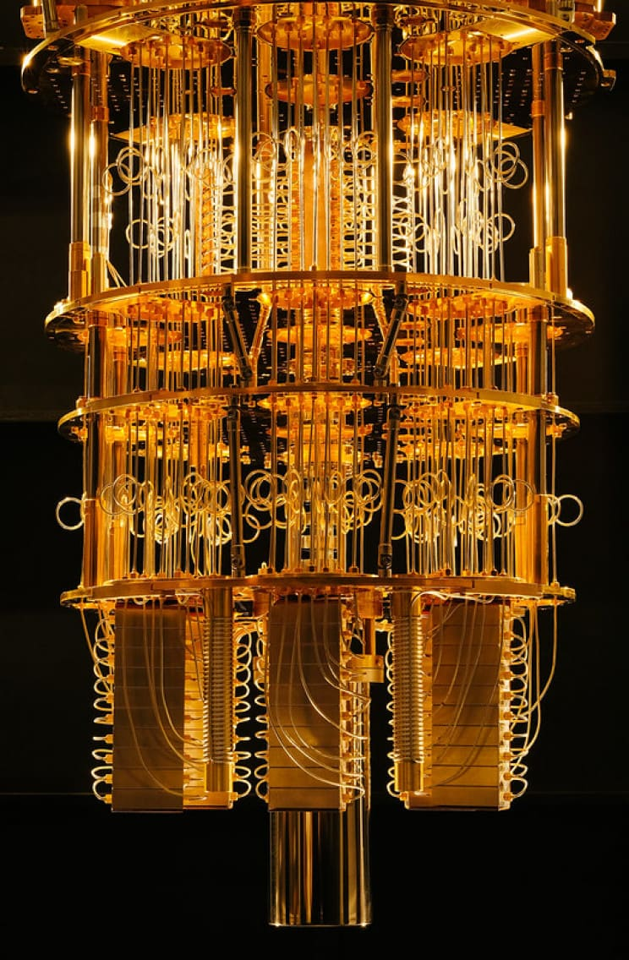
Quantum Computing
Quantum computing is an emerging technology that harnesses the properties of quantum physics to perform calculations
Quantum algorithms use these features to run much faster – e.g., Shor’s Algorithm
The speed could lead to much more efficient artificial intelligence training or world simulation – but it’s a long way off
Notes:
No need to spend too long on this slide…
Let’s talk about quantum computing briefly – I mainly put this here because quantum computers look so cool
Go over the definition – no need to go too deep, just touch on the fact that quantum computers use weird stuff in quantum physics
Quantum algorithms are just algorithms that use quantum computing – for example, Shor’s Algorithm – that could potentially break cryptography (meaning someone could hack pretty much anything on the internet)
Sum this up by mentioning that the speed of these computers could drastically increase the efficiency of things like AI or world simulation – but the technology is still a long way from that.

